Slide 1

Walmart Sales EDA and Clustering

Slide 2
Packages used
"dplyr": Used for data manipulation, including data filtering, data aggregation, data transformation, and data summarization.
"ggplot2": Used for data visualization, creating a wide range of static and dynamic plots.
"scales": Used for modifying the scales and aesthetics of data visualizations created with ggplot2.
"zoo": Used for time series data analysis and manipulation, including handling irregular time series data.
"tidyverse": An ecosystem of packages for data wrangling and data visualization in R, including dplyr, ggplot2, and tidyr.
"tidyr": Used for data cleaning and tidying, including handling missing values, reshaping data, and filling gaps in data.
"lubridate": Used for working with dates and times in R, including parsing, manipulating, and formatting date-time objects.
"car": Used for regression diagnostics and visualizations, including residual plots, influence diagnostics, and variance inflation factor (VIF) calculations.
"stats": A core R package for statistical functions and procedures.
"corrplot": Used for creating correlation plots and matrices to visualize correlations between variables.
"caTools": Used for data preprocessing, including data sampling, variable encoding, and splitting data into training and testing sets.
"MLmetrics": Used for evaluating machine learning model performance with various metrics, including accuracy, precision, recall, F1 score, etc.
"repr": Used for controlling the representation of objects in R, including customizing the display of data structures and outputs in the R console.

Slide 3
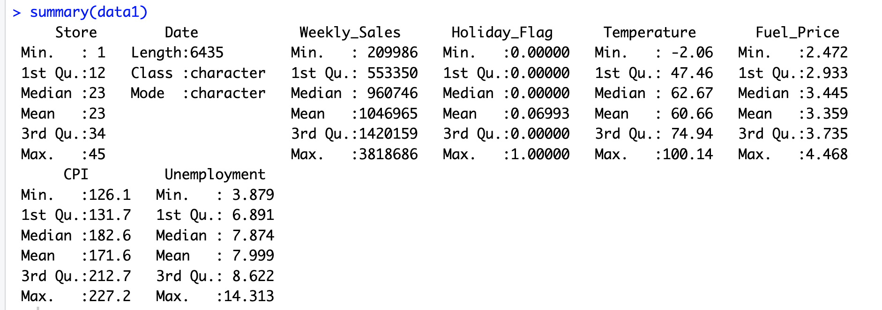
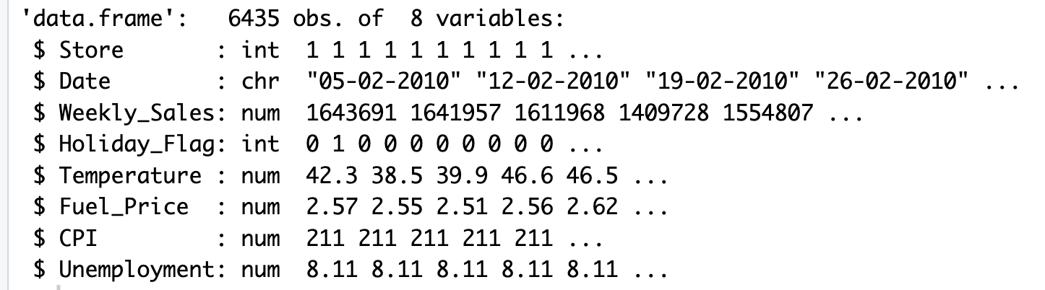
Initial Data Exploration of the dataset
In the dataset there are 8 columns- Store, Date, Weekly_Sales, Holiday_Flag, Fuel_Price, CPI, Unemployment. There are no NA values and no duplicate values.
Dimensions: There 6435 rows and and 8 columns.
Structure:
Summary:

Slide 4
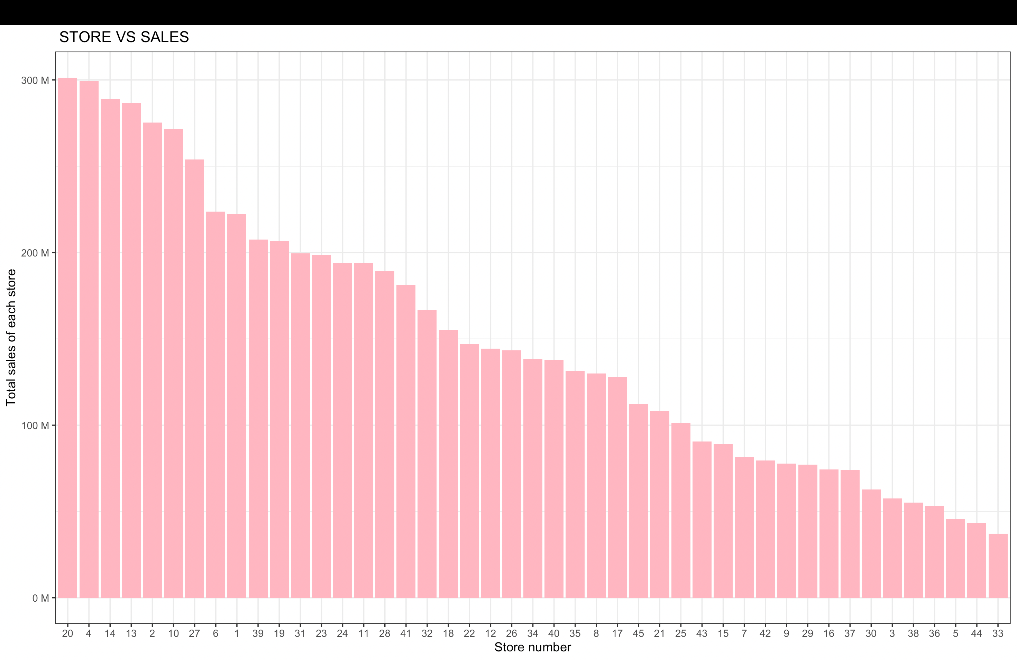
Store with Maximum Standard Deviation
The "Store_Sales" code aggregates the "Weekly_Sales " data by store from the "data1" dataset using the "aggregate" function in R. The column "Weekly_Sales" has been renamed to "Total_Sales_by_Store".
The stores have been sorted based on sales in descending order using the arrange() function from the dplyr library.
It has been determined that “Store 20” has the highest sales.
"Store no. 20 has the maximum sales and the value is = 301397792.46”
Store 4 is the second largest store in terms of sales and the value is 299543953 Store 33 has the least sales 37160222

Slide 5
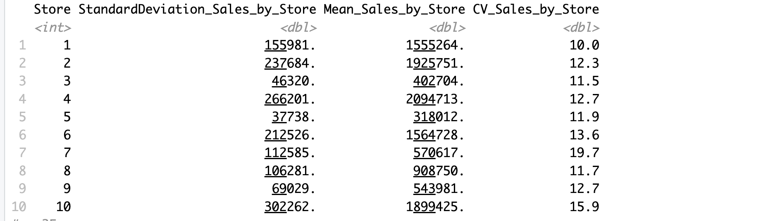
Sales Distribution
To aggregate data by 'Store' and calculate the standard deviation of 'Weekly_Sales’ we used aggregate function.
Calculated the standard deviation and mean of 'Weekly_Sales' by 'Store' using the 'summarise' function from the 'dplyr' package and stored the results in a new dataframe called 'Store_Sales_Variation'. The columns "StandardDeviation_Sales_by_Store" and "Mean_Sales_by_Store" are renamed from "sd(Weekly_Sales)" and "mean(Weekly_Sales)" respectively.

Slide 6
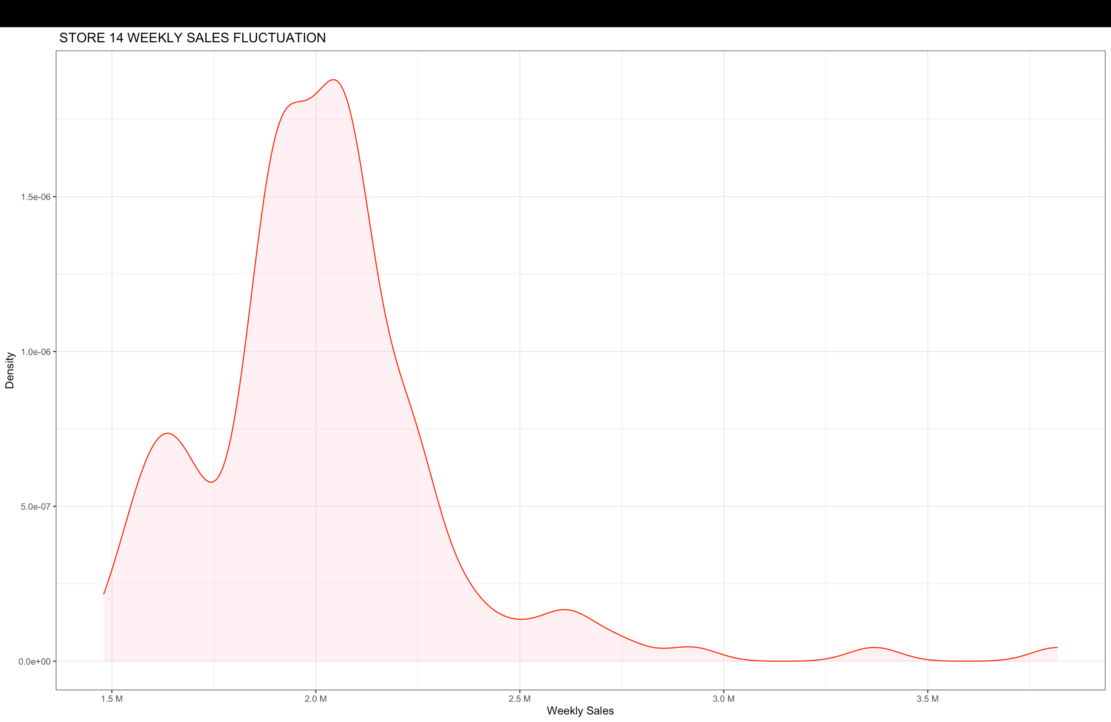
Insights and Observations
In the Store_Sales_Variation dataframe it it found that “row 14“ has the highest standard deviation of sales. And it is stored in “store_sales_max_std” tag.
The highest SD of sales value is recored to be 317569.9. And the value is stored in the tag “max_sd”
Row 14’s coefficient of variation (CV) value is stored into tag CV_max_sd .
"Store no. 14 has the maximum standard deviation of 317569.949475508 Coefficient of Variation = 15.7136736009483”
Created a density plot for the sales distribution of Store 14, visualizing the distribution of weekly sales in a graphical form.

Slide 7
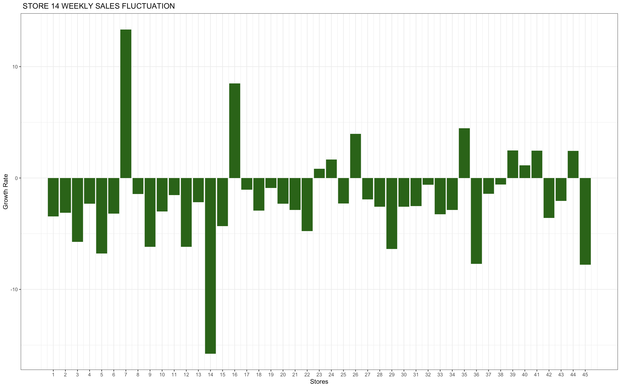
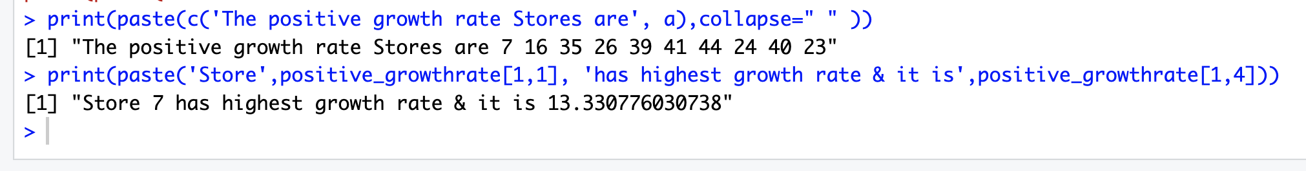
Sales Growth Analysis
The data in the dataset "data2" was prepared for analysis by creating a column for month-year using the "substr" function. Subsequently, the data was further subsetted into two quarters, Q3-2012 and Q2-2012, based on the month-year values.
The functions "summarize" and "group_by" are utilized to aggregate sales data by store for both the Q3-2012 and Q2-2012 quarters. The resulting columns are then renamed as "Q3_2012_Sales_by_Store" and "Q2_2012_Sales_by_Store" respectively for improved readability.
The "mutate" function calculates the growth rate of sales for each store by comparing the sales in Q3-2012 with Q2-2012, and creates a new column called "Growth Rate". It then filters and arranges the data to identify stores with positive growth rates.
It is found that store 7 has the highest growth rate

Slide 8
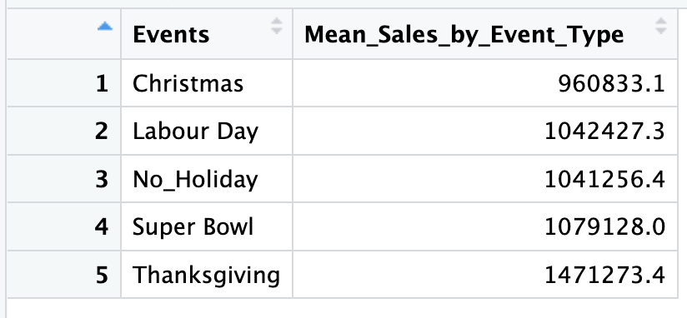
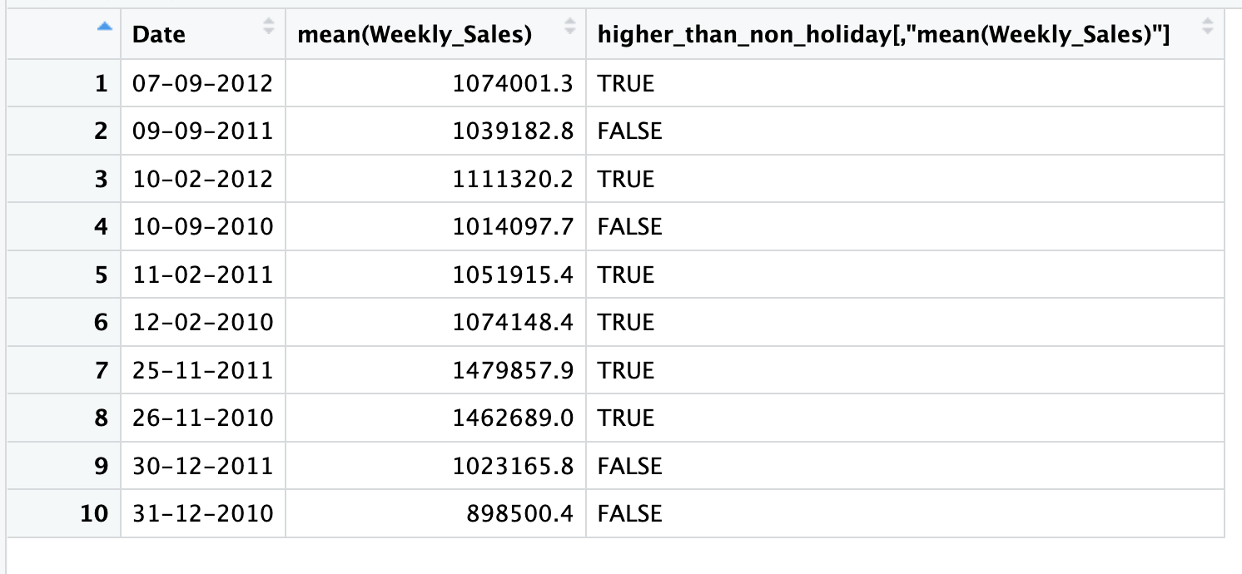
Holiday Sales Analysis
We have identified American holidays, created a vector with their dates, and another vector with the holiday names, and formed a data frame name “Holidays_Data”. The “Holidays_Data” is further merged with “data1” to create data3 for further analysis. The Null values in “Event” column are replace with “No_Holiday”.
It has been initially identified that Christmas and Labour Day negatively impact sales, as their average sales are lower compared to non-holiday seasons. Conversely, Thanksgiving and the Super Bowl have a positive impact on sales.
After further analysis it is found that Super Bowl, Thanksgiving, and Labour Day exhibit higher sales compared to the mean sales of non-holiday periods, resulting in a positive impact on overall sales. On the other hand, dates such as 9th September 2011, 10th September 2010, 30th December 2011, and 31st December 2010 have been observed to create a negative impact on sales.
Christmas-related dates tend to have lower sales compared to the mean, whereas dates associated with Super Bowl and Thanksgiving have higher sales. Labour Day still has an overall positive impact on sales.

Slide 9
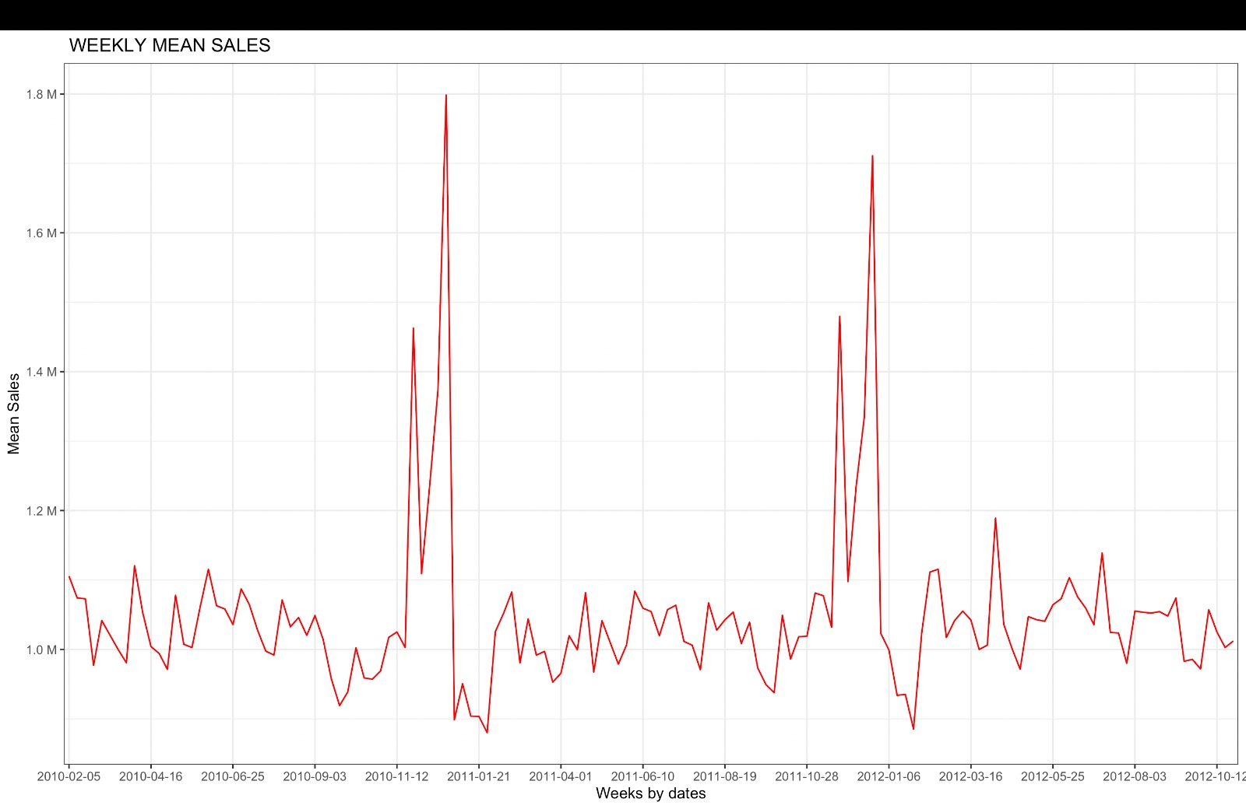
Plotting Weekly Mean Sales
Though Super Bowl, Labour day have higher sales they are very close to mean.Thanks giving does create a high positive impact on sales than others.Christmas Holiday Flag has lower sales than mean sales of a Non Holiday. Both the dates (30- Dec-2011, 31-Dec-2010 ) related to Christmas has negative impact on sales. However, from the graph it is clear that the week just before the Christmas bagged highest sales. It may be because customers did shopping beforehand for preparation/ Advent is popularly celebrated there.

Slide 10
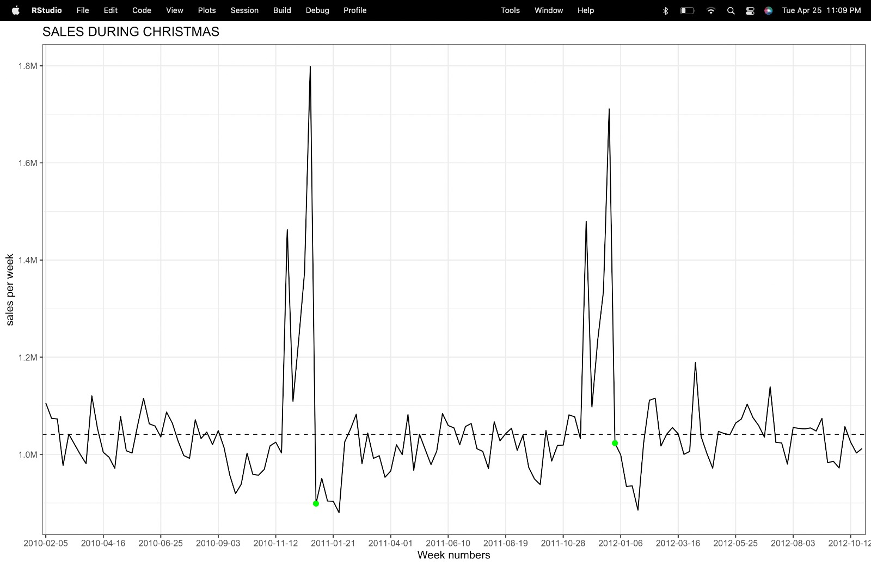
Plotting Christmas Sales for 2010-12-31 and 2011-12-30

Slide 11
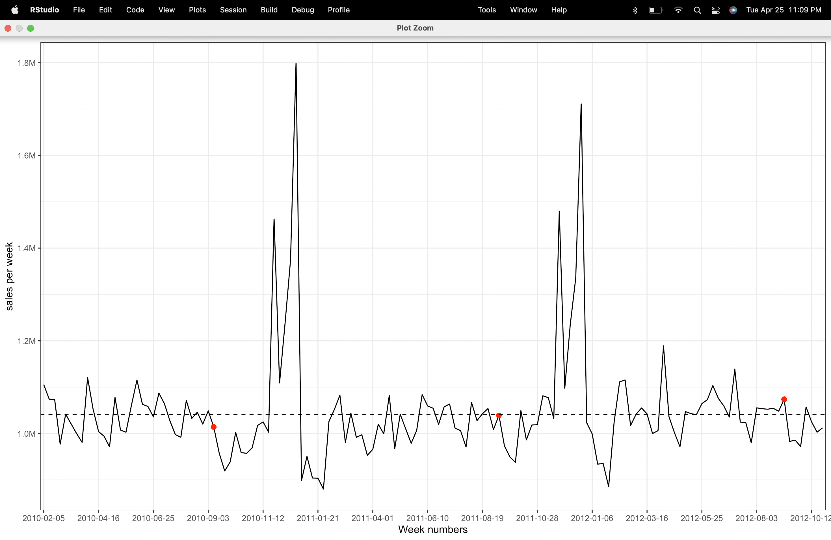
Plotting Labour Day Sales for 2010-09-10, 2011-09-09, and 2012-09-07

Slide 12
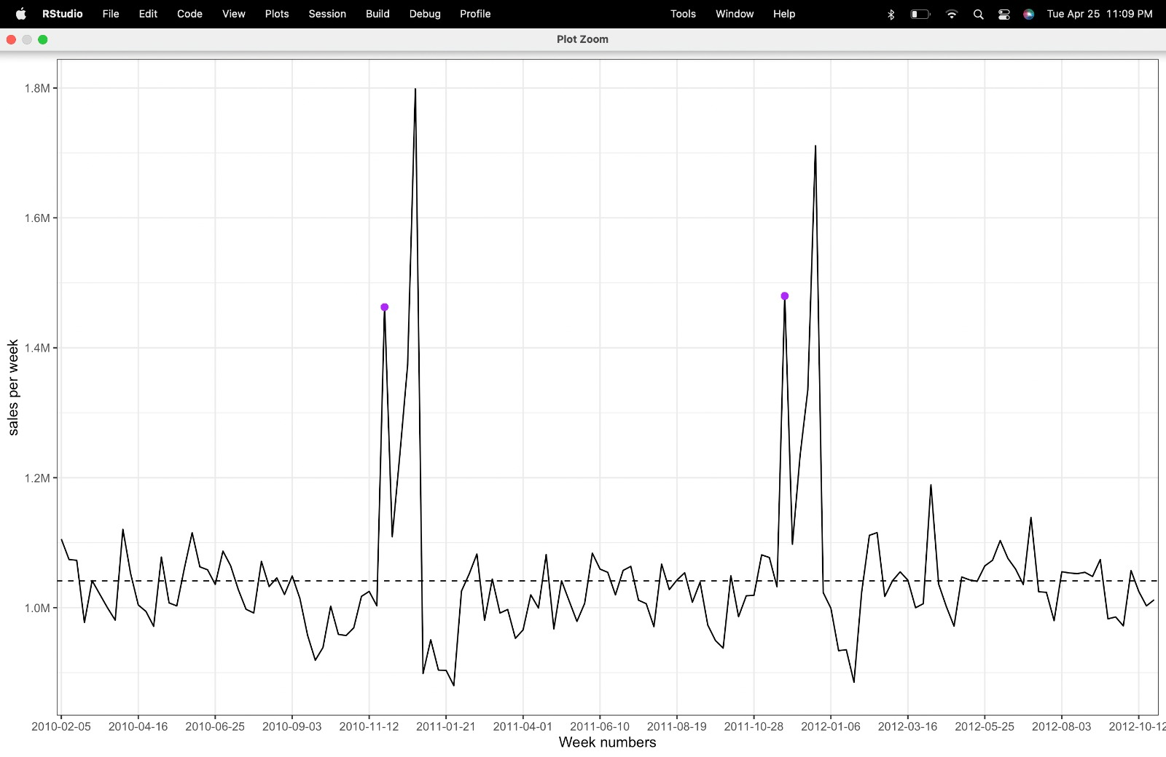
Plotting Thanksgiving Sales for 2010-11-26 and 2011-11-25

Slide 13
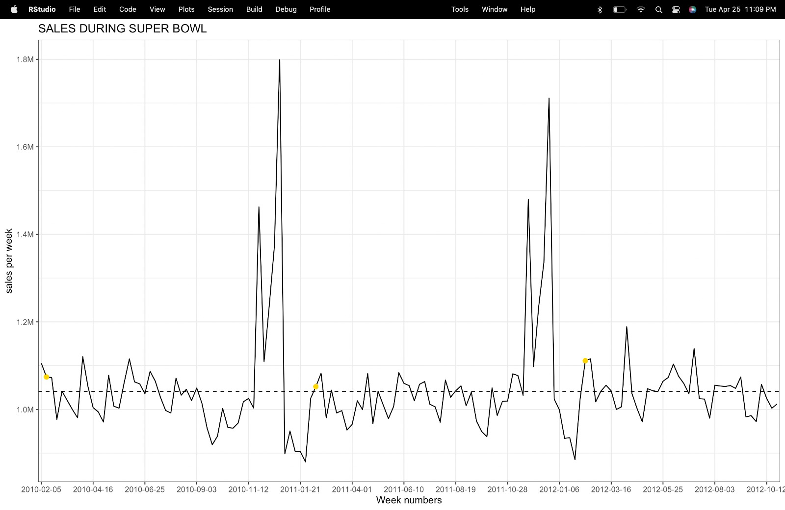
Plotting Super Bowl Sales for 2010-02-12, 2011-02-11, and 2012-02-10

Slide 14
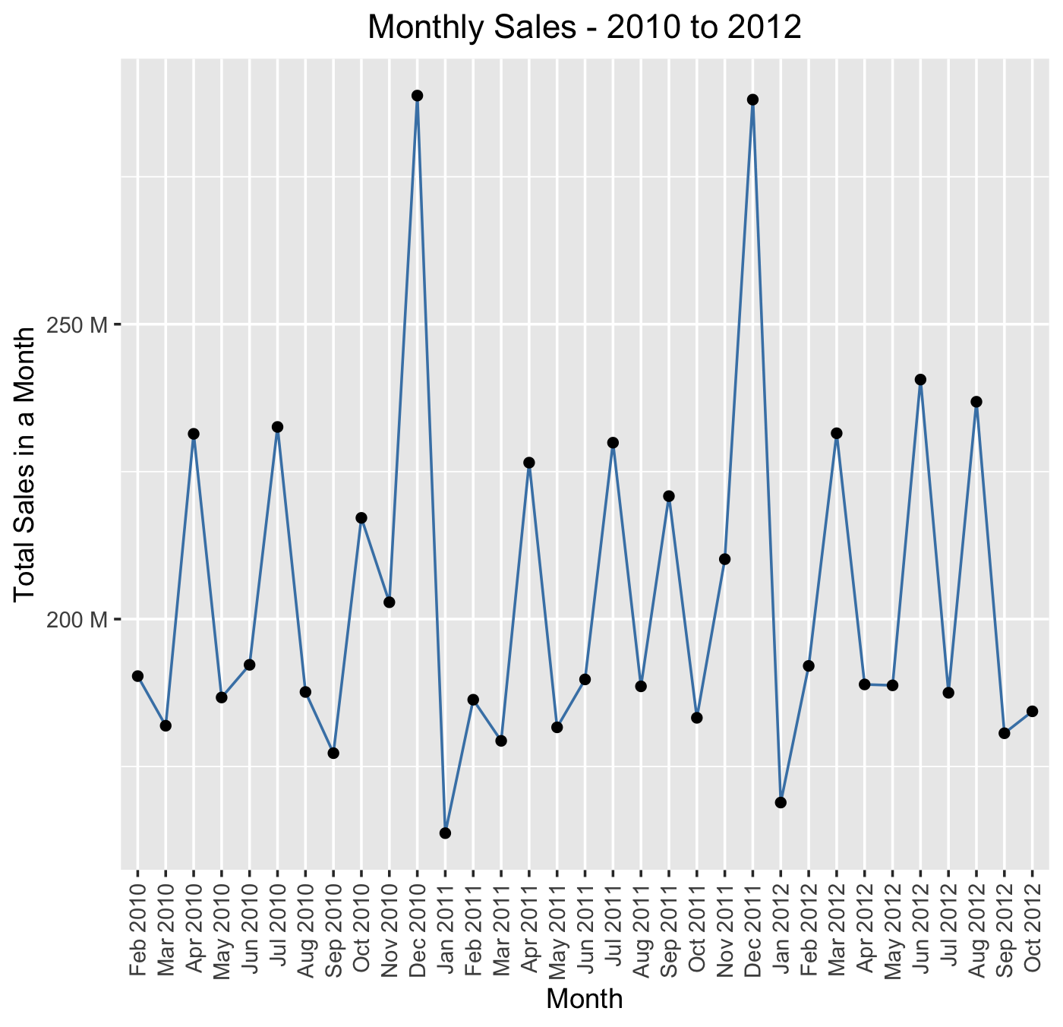
Monthly Sales Trend (2010-2012)
The line graph represents the trend of monthly sales from 2010 to 2012.
Each data point on the line represents the total sales for a particular month-year, as aggregated from the original dataset.
The graph also includes individual data points as circles, representing the actual sales values for each month-year.

Slide 15
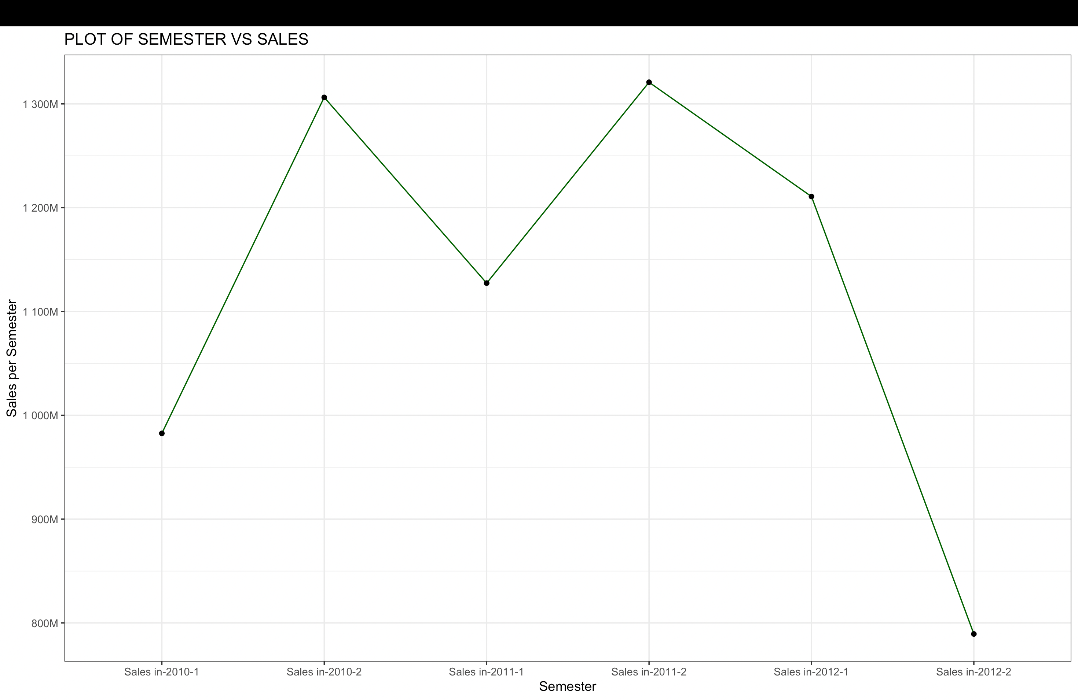
Sales vs Semester Analysis
The 'Date' column’s format is changed by using the 'dmy' function from the 'lubridate' package.
A new column 'sem' is created that represents the semester with year information using the 'semester' function from the 'lubridate' package.
A new dataframe 's' is created by aggregating the total sales for each semester using the 'aggregate' function. And a new column 'sem_year' is created by concatenating the year and semester information in a different format using the 'paste' function.
Sales tend to peak in December and hit their lowest point in January. Additionally, sales are typically higher during the second semester of each year.
The plot shows a drop in S2-2012 & S1-2010. It is due to absence of Jan data in S1-2010 & Nov-Dec 2012 data in S2-2012.

Slide 16
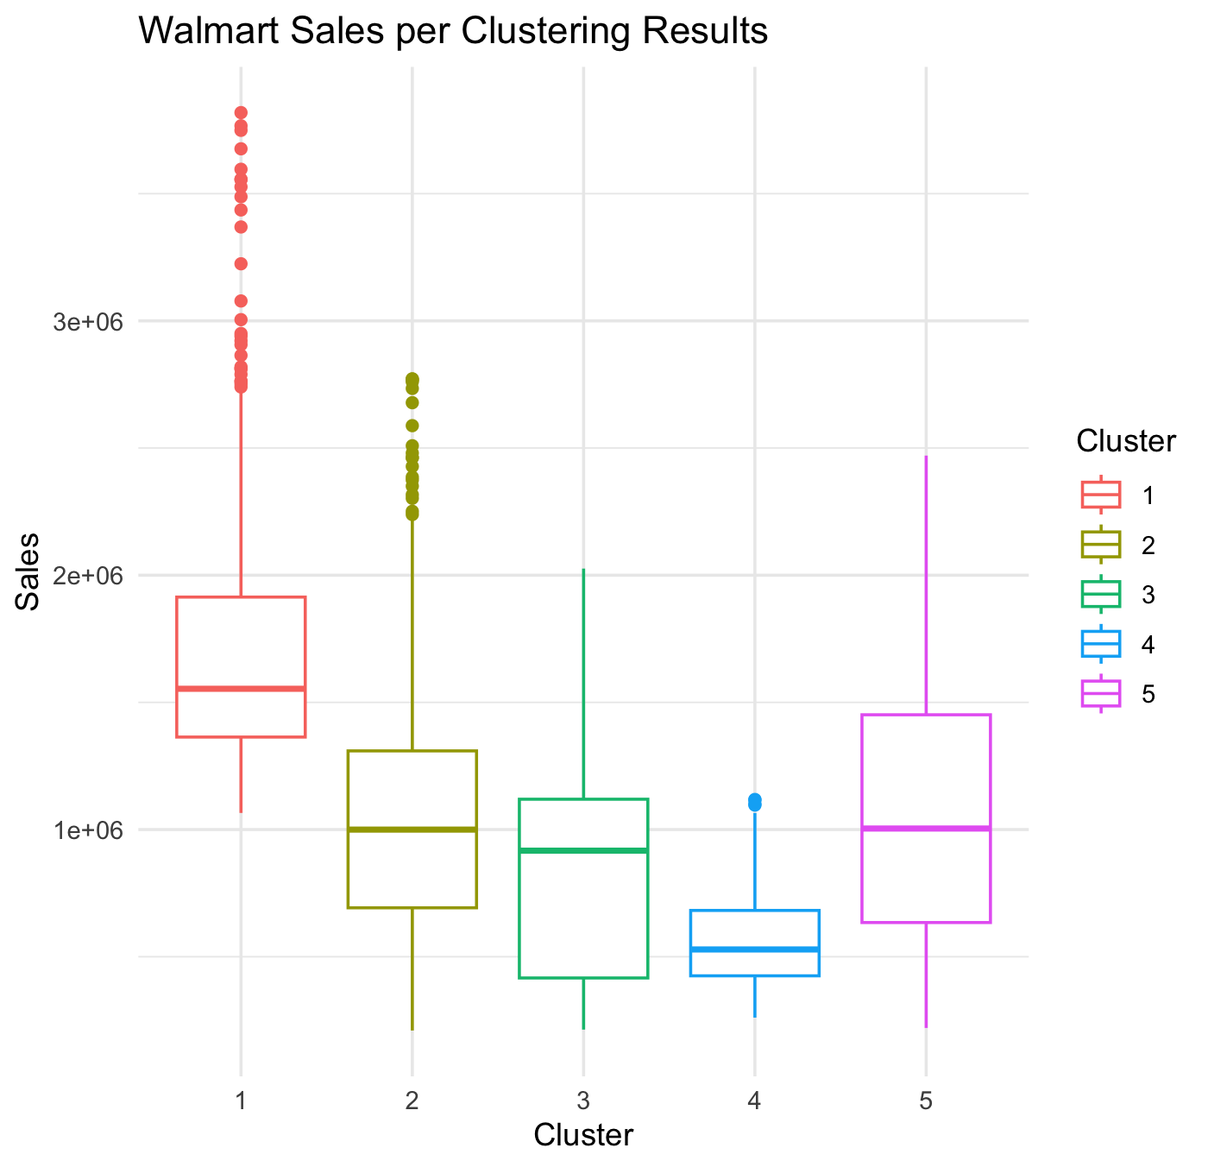
Data Exploration and Preprocessing
Relevant variables for clustering, including "Store", "Weekly_Sales", "Temperature", "Fuel_Price", "CPI", and "Unemployment", from the Walmart sales dataset and “scale” function is used to standardize their values which is often necessary in clustering algorithms to ensure that variables are on a comparable scale and have equal influence on the clustering process.
A new data frame named "walmart_cluster_scaled" is created to store the scaled variables for further analysis in the clustering process.
k-means clustering is performed on the scaled variables in the walmart_cluster_scaled dataset using kmeans() function with 5 specified centers and 25 random starts. And its structured is examined.
Cluster centers and cluster labels from the k-means cluster are printed using walmart_kmeans$centers and walmart_kmeans$cluster, respectively. The clusters are then factorized. Finally, a boxplot is created.

Slide 17
THANK YOU

